Slide 1



Acorns: Paycheck Protection Program Analysis
April 19, 2023

Slide 2





Meet the Team
Paula Simonetti
Emma Watkins
Zach Labkovski
Cassidy Gasteiger
Omar Mikawi

Slide 3

Table of Contents
1. Introduction and Background
2. Data Exploration
3. Modeling and Evaluation
4. Findings and Conclusions
Notes:
Paula

Slide 4




Our Goal
INTRO AND BACKGROUND
Understand the need for Small Business Association Paycheck Protection Program loans based on labor market data so loan providers can better prepare for a future economic shutdown event
IMPACT ANALYSIS
IMPACT FORECAST
DEMAND FORECAST
Assess impact of the pandemic shutdown by analyzing county and industry impacts in Georgia
Predict impact of the pandemic shutdown in terms of job loss based on pre-shock county attributes
Predict number of PPP loans received by county and total dollar amount of loans received by county based on county attributes

Slide 5

Business Case
INTRO AND BACKGROUND
PPP loans:
By understanding the impact of jobs lost and the demand for loans, we can forecast future need, if another pandemic were to occur.
Why Acorns cares:
Acorns does not currently offer loans as part of their services. However, start-ups such as Blueacorn and Womply provided support for small businesses needing PPP loans and reaped more than $3 billion from fees.⁽¹⁾ Acorns targets a similar underserved market and if properly prepared could reap the same benefits in the case of a future government loan program.
1) https://www.nytimes.com/2021/06/27/business/ppp-relief-loans-blueacorn-womply.html

Slide 6
Table of Contents
1. Introduction and Background
2. Data Exploration
3. Modeling and Evaluation
4. Findings and Conclusions
Notes:
Paula

Slide 7



Literature Review: Labor Impacts
LITERATURE REVIEW
Key Impact Factors
__
Worker classification:
work-from-home ability
essential vs. non-essential
Wage cuts
Policy response (i.e., CARES Act)
Demographic data
Educational attainment
Industry (SAIC)
Recovery rates
Labor Impact Estimation Approaches
__
Regression models
Industry ratios based on employment type classification
Key Findings
__
Georgia lost 609K non-agriculture jobs from Feb 2020–Apr 2020
Hospitality and Public sector recovery lags
Higher rates of unincorporated self-employment post-COVID
Recovery rates differ by segment:
Black Georgian’s underemployment rose 300 basis points compared to pre-COVID levels
White women’s un- and under-employment rate also did not recover to pre-COVID levels
White and Hispanic men’s employment recovered to pre-COVID levels in the same timespan

Slide 8
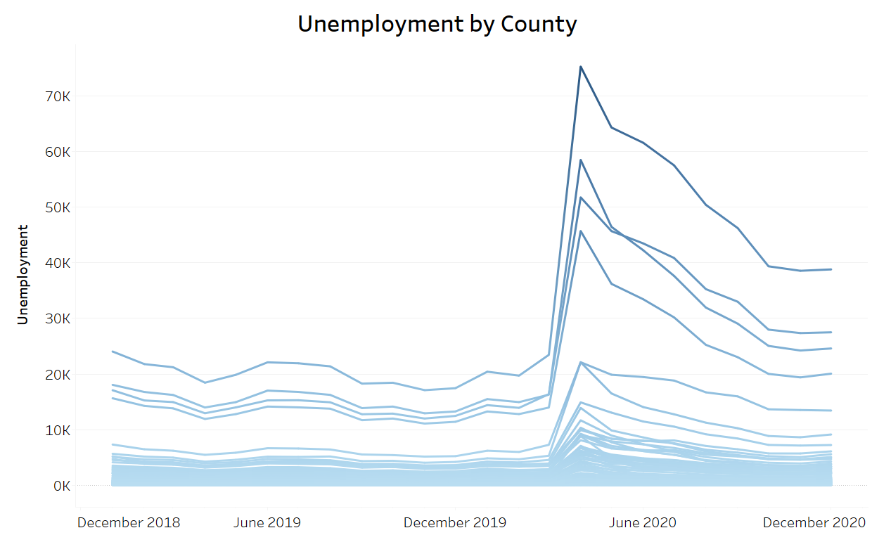
DATA EXPLORATION
Labor Impact At-a-Glance
Unemployment spikes in March 2020 across all counties and begins to recover in April 2020
13.8%
12.4%
13.4%
Fulton
546,995
9.2%
11.4%
jobs lost in April
jobs lost on average in April
Decatur
Gwinnett
Cobb
27.1%
10.51%
of jobs lost in Berrien County (most-impacted)
Avg. April 2020 unemployment rate

Slide 9
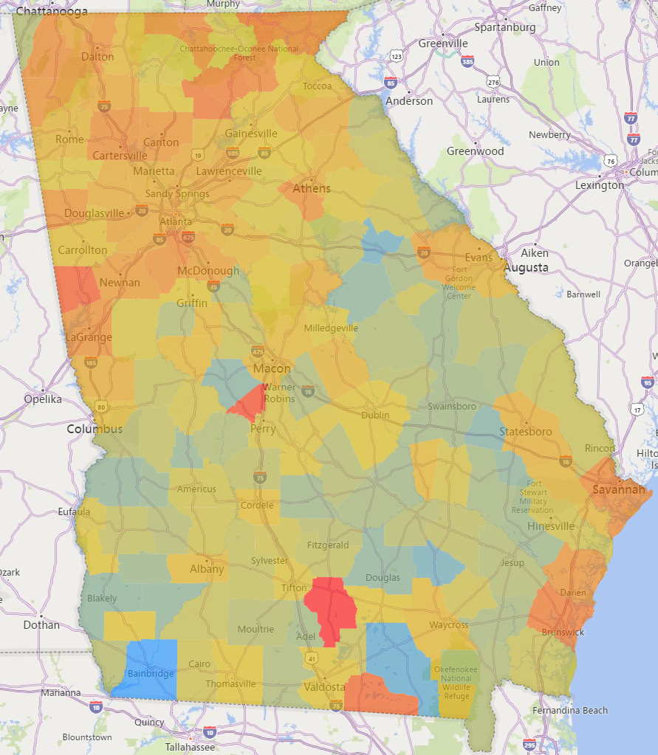
DATA EXPLORATION
Labor Impact by County
Heatmap of Job Loss Ratio from March – April 2020 by County
The space in between the red lines is known as the "Piedmont Region" and is represented by smaller businesses and population sizes
The Piedmont Region experienced less intense labor impacts from COVID-19 because of its quantity of agricultural jobs, political leanings, lack of restaurant and retail jobs, and small-town effect.
Greatest job loss as percent of total jobs (Berrien County)
Lowest job loss as percent of total jobs (Decatur County)

Slide 10
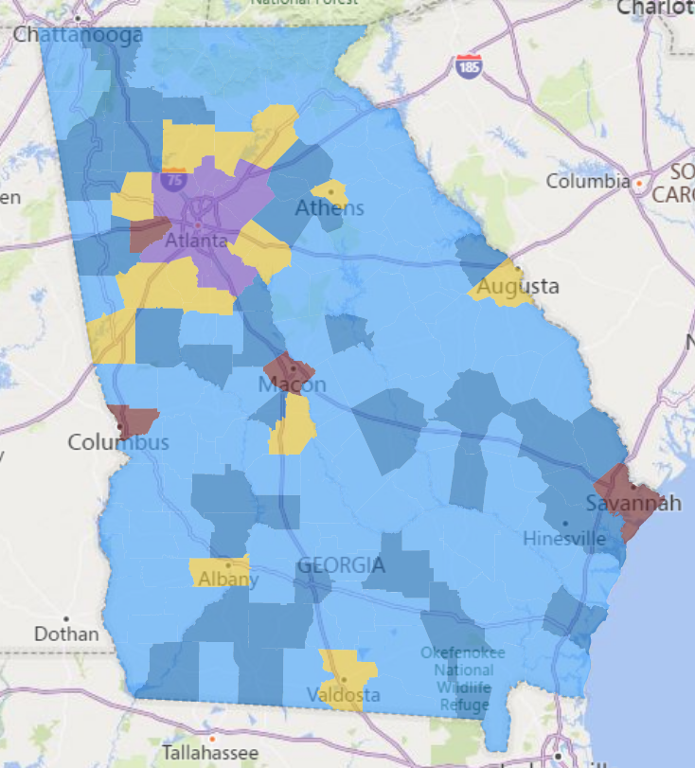
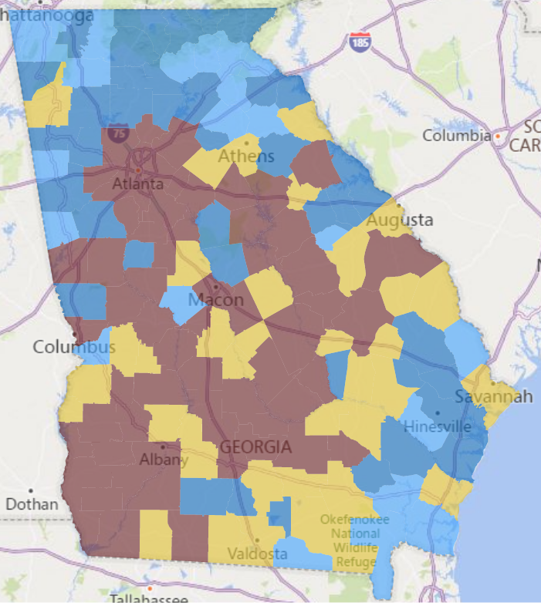
DATA EXPLORATION
PPP Loans At-a-Glance
Loans were distributed at the same rate when you compare on a portion of the population basis, but they were smaller loans because a lot of people became self-employed and leaned into their side business.
Count of PPP Loans Issued by County
Count of PPP Loans Per 10K Labor Force Issued by County
< 1,000 loans
< 500 loans
1,000 – 5,000 loans
500 – 750 loans
5,000 – 10,000 loans
750 – 1,000 loans
10,000 – 15,000 loans
>1,000 loans
>15,000 loans
$25,724,311,477
584,485
$43,661
4.74
in PPP loans granted
total PPP loans issued
average loan amount
average company size

Slide 11
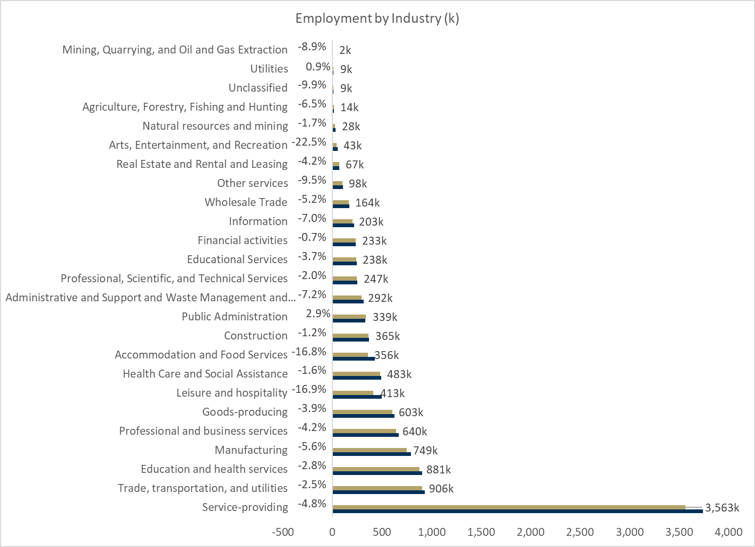
Labor Impact by Industry
DATA EXPLORATION
Employment by Industry (k)
Service-providing lost 171k jobs, more than any other industry
Art, Entertainment, and Recreation has the largest percent change of -22.4%
Public Administration and Utilities had a net increase in jobs
Financial Activities had the smallest percentage change at –0.7%
Count of Dec 2019 (pre-pandemic) jobs in Georgia by industry
Count of Dec 2020 (post-pandemic) jobs in Georgia by industry
%
Percent change from 2019 to 2020
#
Number of jobs in 2020

Slide 12
Table of Contents
1. Introduction and Background
2. Data Exploration
3. Modeling and Evaluation
4. Findings and Conclusions
Notes:
Paula

Slide 13


Modeling Approach Labor & Loan Impacts
MODELING
13
FEATURE ENGINEERING
FEATURE SELECTION
MODELING
Separate time series and baseline data and develop secondary variables
Used March 2020 as baseline (or December 2019 for annualized features)
Derived ratios for most features and normalized the rest to adjust for population
Identified y variables to model
Remove highly collinear variables and select most-correlated features for further modeling
Compared VIF scores
Compared p-values while dropping and adding variables
Forward feature selection in random forest model
Lasso regression
Test linear regression approaches to build an accurate and interpretable model
Multivariate linear regression
Lasso regression
Random forest regression
Notes:
Zach

Slide 14
MODELING
Model Features
Explanatory Variables Tested
Population
Total population
High population binary flag (if county population > 500,000)
Target Variables Modeled
Job Loss
Total number of jobs lost in a county
Employment
Labor force
Percent of population in the labor force
March employment (number of people employed in the county in March)
Unemployment rate (as of year-end Dec. 2019)
Commuter ratio
Average working adults/household
Loan Demand
Total number of loans received by a county
Loan Amount
Total dollar amount received in loans by a county
Self-Employment
Self-employment as percent of workforce
Non-employer establishments as percent of total establishments
Industry Mix
Total establishments
Percent of total establishments belonging to each of 31 NAICS industry codes
Wealth Proxy
Average weekly wages

Slide 15
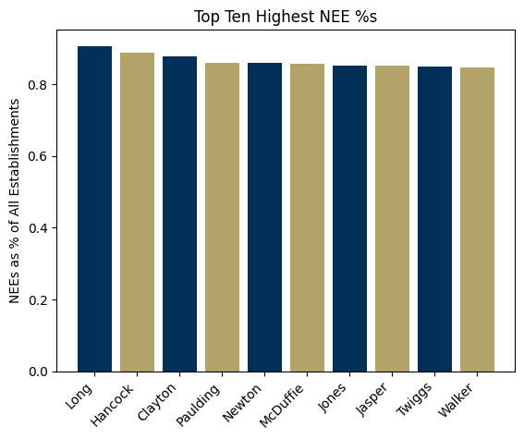
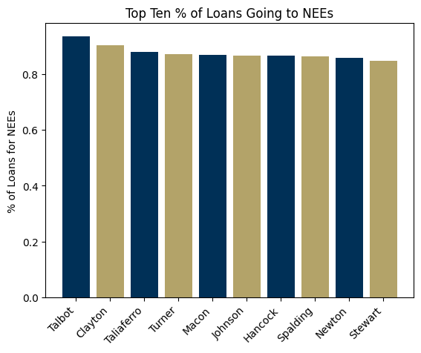
Non-Employer Establishments
MODELING
39.9%
86.2%
A non-employer establishment (NEE) is a company that has no paid employees.
This includes gig economy workers and self-employed people.
of loans went to NEEs
issued in Phase II

Slide 16
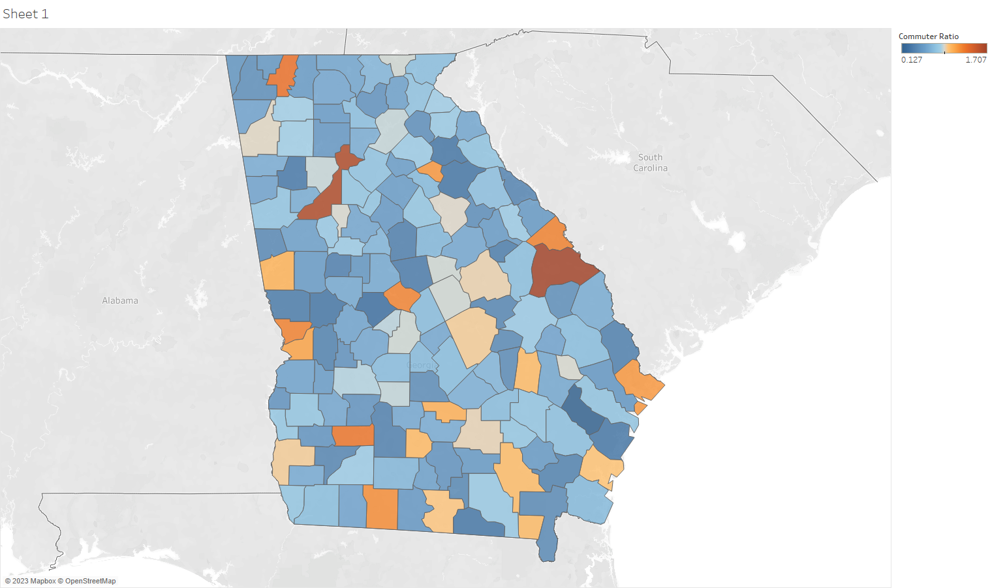
Commuter Ratio
MODELING
Heatmap of Commuter Ratio by County
Local area employment measures number of people employed in a county; employment measures number of people living in a county who are employed
Taking local area employment / employment gives us a commuter ratio: a sense of how many people are commuting into the county to work
Counties with a high concentration of jobs (Fulton – Atlanta Metro Area, Chatham – Port of Savannah, Burke – Nuclear Power Plant) have high commuter ratios compared to some rural counties with very low ratios (Long, Crawford)
Much of the Piedmont Region has a commuter ratio close to 1; most people live where they work
1.707 (+ ratio)
Net 0 ratio
0.127 (- ratio)
Notes:
Savannah/Chatham county – is a metro center and has a very big port; has moved over 10% of the entire nation’s goods
Burke County – has a nuclear power plant that leads to a very high positive commuter ratio Vogel Power Plant – finished construction in March – set to finish in Dec, it’s also construction

Slide 17
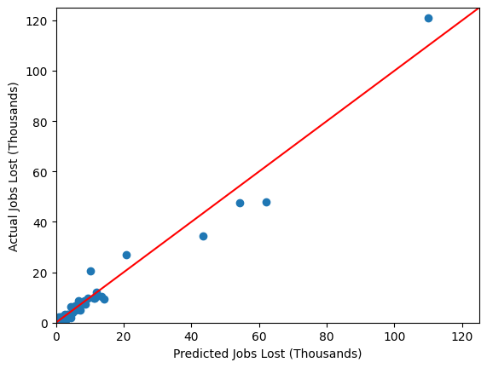
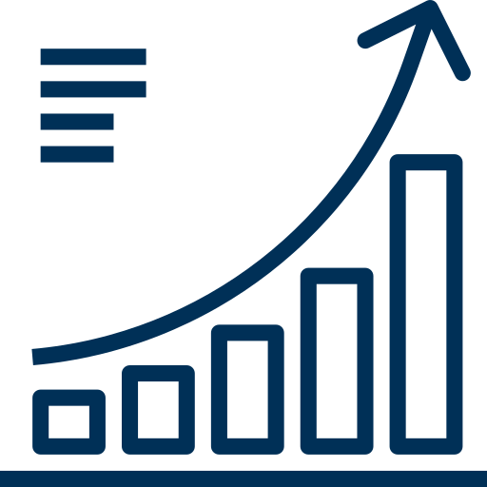
Predicting Job Loss
MODELING
PERFORMANCE
PREDICTIONS
Linear Regression R2 Score: .963
Cobb
Actual: 23,220
Predicted: 47,519
KEY FEATURES
1
Total Establishments
2
Commuter Ratio
Cherokee
Actual: 10,428
Predicted: 13,458
Jackson
Actual: 3,152
Predicted: 3,506

Slide 18
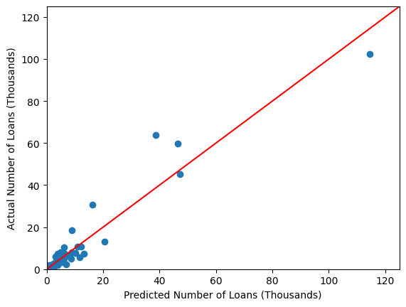
Predicting Loan Demand
MODELING
PREDICTIONS
PERFORMANCE
R2 score: .962
Fulton
Actual: 102,263
Predicted: 114,549
KEY FEATURES
1
March employment
Cobb
Actual: 45,353
Predicted: 47,327
Self-employment percentage (applied Box-Cox transformation to normalize residuals)
2
Baker
Actual: 189
Predicted: 224

Slide 19
Predicting Loan Amount: Feature Selection
MODELING
PERFORMANCE
Linear Regression R2 Score: 0.995
Model Features | Adj R2 Score
Employment | 0.9877
Emp, NEE/Workforce | 0.9897
Emp, NEE/W, Avg Weekly Wages | 0.9896
Emp, NEE/W, High Density | 0.9944
Emp, NEE/W, HD, HD Interaction | 0.9956
FINAL FEATURES
1
March employment (population metric)
2
Non-employer entity rate: NEE/workforce
3
"High Density" County Binary Variable: 1 if pop > 500k, 0 otherwise

Slide 20
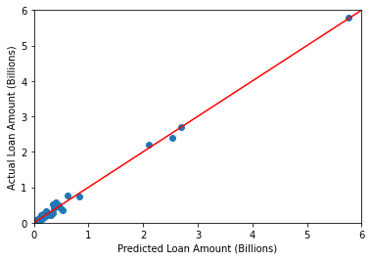
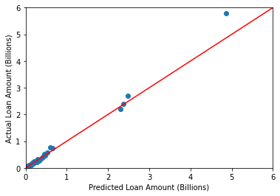
Predicting Loan Amount: Model Validation
MODELING
LINEAR REGRESSION
RANDOM FOREST
MAPE: 81.81%
MAPE: 13.21%

Slide 21
Table of Contents
1. Introduction and Background
2. Data Exploration
3. Modeling and Evaluation
4. Findings and Conclusions
Notes:
Paula

Slide 22
FINDINGS
Key Findings
22
Job Loss
__
A linear regression model can accurately predict job loss in an economic shutdown based on pre-pandemic labor conditions.
While other variables were highly correlated with job loss by county, the shutdown was so massive and so quick that the only significant predictive variables were population and commuter ratio (that adjusts for the employed in other county, unemployed in-home county disparity).
Loan Demand
__
A linear regression model can accurately predict demand for PPP loans by county.
Demand for loans is mostly a function of population and number of self-employed people, as these are the people who are most likely to need access to loans to keep their small businesses afloat during a crisis.
Loan Amount
__
A random forest model can most accurately predict the demand in dollar amount of PPP loans.
The biggest hurdle to overcome was the difference between high population and low population counties; interaction terms solved this issue.

Slide 23
Business Recommendations
FINDINGS
23
1
COUNTY FOCUS
2
EARLY ADOPTERS
3
GENERALIZABILITY
NEEs initially had trouble accessing loans, as evidenced by the much higher percentage of second-draw PPPs going to NEEs
Acorns’ user-friendly approach makes it an ideal candidate for working with small businesses; it should target NEEs and share information about loan opportunities early to capture this market share immediately
Our analysis focused on Georgia, but we expect many of these trends to hold nation-wide
Further research could test generalizability of our findings to other states
Counties with lower population, high commuter ratio, and high NEE percentages had the highest demand for PPP loans per person
Targeting these more rural counties in the case of a future government small business loan program could allow Acorns to maximize their reach

Slide 24


Thank You
Any Questions?

Slide 25
References
APPENDIX
25
Labor Impact References
__
Osborne Jackson. “An Approach to Predicting Regional Labor Market Effects of Economic Shocks: The COVID-19 Pandemic in New England.” Federal Reserve Bank of Boston. June 29, 2020.
Charles Gascon. “COVID-19: Which Workers Face the Highest Unemployment Risk?” Federal Reserve Bank of St. Louis. March 24, 2020.
Ray Khalfani. “State of Working Georgia: Pandemic Job Numbers Show Ongoing Progress at the Surface, but Inequities Persist Below.” GBPI. May 12, 2022.
Loan Classification References
__
John M. Griffin, Samuel Kruger, and Prateek Mahajan. “Did Fintech Lenders Facilitate PPP Fraud?” Journal of Finance. 2021.
“Small Business Administration Paycheck Protection Program Phase III Fraud Controls.” Pandemic Response Accountability Committee. January 1, 2022.
Office of Inspector General. “Inspection of SBA’s Implementation of the Paycheck Protection Program.” U.S. Small Business Administration. January 14, 2021.

Slide 26
What is a PPP loan?
Additional Background
APPENDIX
26
Paycheck Protection Program (PPP) is a business loan program established by the United States federal government in 2020 through the Coronavirus Aid, Relief, and Economic Security Act (CARES Act)
Provides low-interest private loans to pay for small business’s payroll and certain other costs
The amount of the PPP loan was based on the applicant's payroll costs
Approximately $800 billion in low-interest uncollateralized loans from April 3, 2020, through May 31, 2021.

Slide 27
Suspect Loan Analysis: Lit Review
APPENDIX
27
Key Findings
__
1.8M of PPP’s 11.8M loans showed signs of fraud nationwide
~$78B in PPP money taken illicitly
Most common fraud: business didn’t exist before Feb. 2020
PPP program had very limited review process and relied on lender for all determinations
Most cases of flagged loans have gone uninvestigated
Key Detection Factors
__
Non-registered businesses
Multiple businesses at residential addresses
Abnormal compensation per employee
Inconsistencies with other government programs
Fraudulent Loan Detection Outcome
__
Data available was for rejected applications, not fraudulent loans
We are unable to complete this investigation, due to data not being available for fraudulent loans

Slide 28
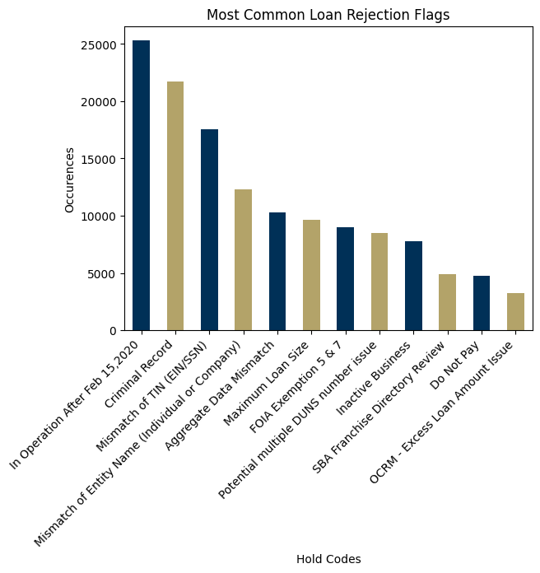
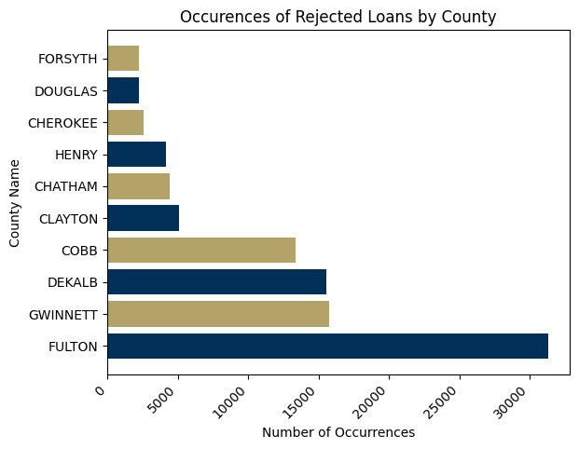
Suspect Loan Analysis: EDA
APPENDIX
28
12
25.27%
flags on
most-rejected applications
of applications rejected

Slide 29
APPENDIX
29
Suspect Loan Analysis: Conclusions
Our Goal
Major Challenges
Our Action
Originally, our goal was to develop a fraudulent loan detection model based on application characteristics using a dataset of PPP loans flagged for review
Lack of matching unique identifiers between SBA PPP loan applicant data and rejected application data
No alternative unique identifier combination to join SBA PPP datasets
Lack of detailed data dictionary or many features for suspect loan data
Missing hold codes (government only released 43 of the possible hold codes in the dataset)
We conducted a literature review and found research that indicated that this analysis was possible
However, we found that the only available data was for rejected applications, not loans that were accepted and later flagged
After analysis of the available data we determined that we would remove this goal

Slide 30
Recovery Analysis: Modeling Approach
APPENDIX
30
FEATURE ENGINEERING
FEATURE SELECTION
MODELING
Develop secondary variables
Response variable:
Recovery rate
Added explanatory variables:
Percent of jobs covered by loans
Loan dollars per job
COVID case rate, death rate
Population density
Total population
Remove highly collinear variables and select most-correlated features
We tested several feature selection methods, including:
Ridge regression
Lasso regression
Auto-selection in random forest and XGBoost models
Test linear regression approaches to determine whether PPP loans are correlated with recovery
Models tested:
Multivariate linear regression
Lasso regression
Random forest regression
Extreme gradient boosting model
Notes:
Zach

Slide 31
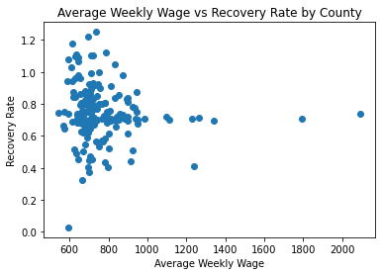
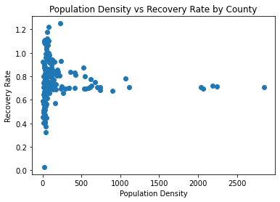
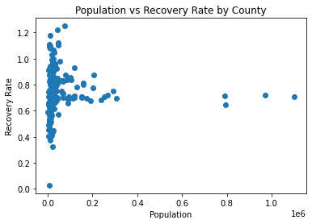
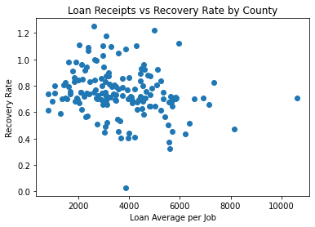
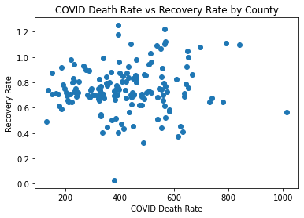
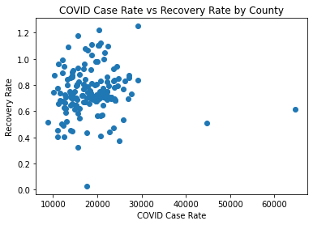
Recovery Analysis: Correlations
APPENDIX
31

Slide 32
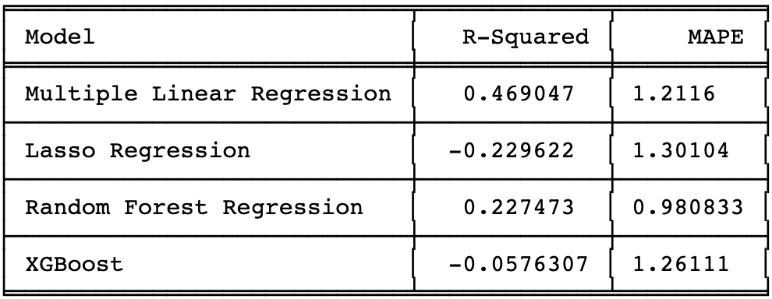
APPENDIX
32
Recovery Analysis: Results

Slide 33
Recovery Analysis: Conclusions
APPENDIX
33
When looking at variables that intuitively may impact recovery on an individual basis, none appeared to be particularly correlated with recovery rate.
All attempted regression modeling techniques yielded models with poor linear fit and large errors when predicting on the test data set.
We did not pursue further analysis on recovery rate given the modeling limitations present with available data.

